Slide 1
NCCNP Survey Web Application
Audrey Bunn, Eve Neal, Kyle Dove, Steven Tucker, Kevin Todd

Slide 2
Our Goal
To create a technological tool for the NCCNP to use to streamline survey assessment communication regarding recommendations, goals, action steps, and outcomes. This tool must be setup to align nonprofits with the ten steps and the twelve principles of the NCCNP.

Slide 3
12 Principles - The Survey
Advocacy and Civic Engagement
Board Governance
Equity, Diversity, and Inclusion
Financial Management
Fundraising
Human Resources
Information and Technology
Legal Compliance and Transparency
Partnerships and Collaboration
Program Design Management and Evaluation
Strategic Communication
Strategic Planning

Slide 4
Capacity Building Process Steps - Project Scope
Step 1: Understand functions of nonprofit management
Step 2: Assess current management capacity
Step 3: Review and analyze capacity assessment
Step 4: Make recommendations for capacity building
Step 5: Establish capacity building goals
Step 6: Determine action steps for building capacity
Step 7: Develop a capacity building action plan
Step 8: Select capacity building products, services, and consultation
Step 9: Implement capacity Building products, services, and consultation
Step 10: Evaluate the impact of capacity building

Slide 5
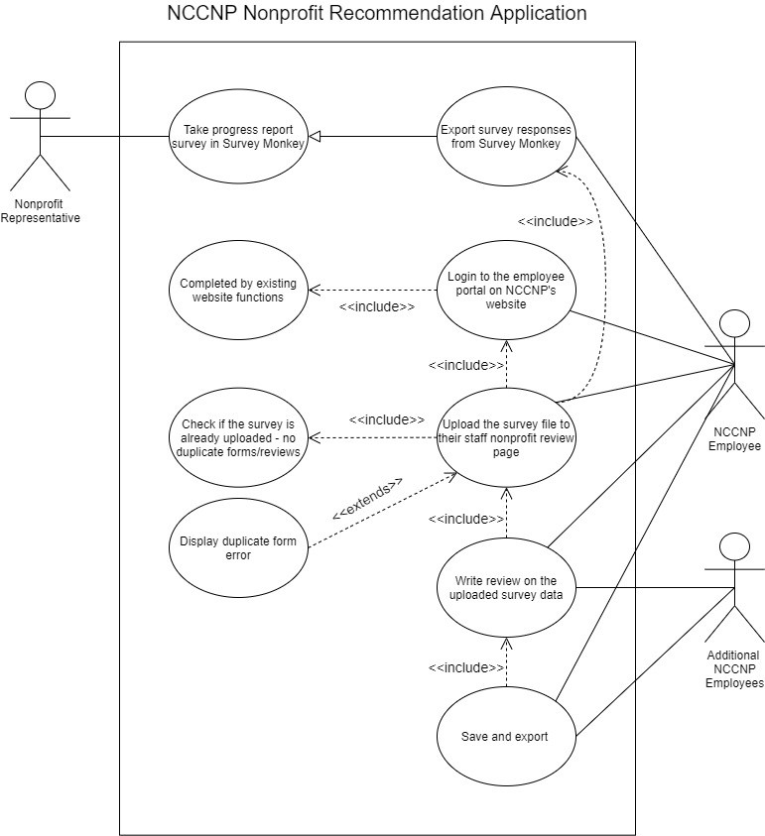
Use Case Diagram
A completed survey is exported from Survey Monkey.
The user launches the application and uploads the survey’s .csv file
The user clicks “recommend”, “goals”, or “action steps” next to the new survey on page 1
They are redirected to the selected page to type responses
When work is complete, the user types in their name and saves the page
The user exports and saves a pdf of the desired steps when they are complete
Notes:
Nonprofit rep. Takes the survey via surveyMonkey to which the NCCNP employee will export the responses and upload the responses into the review page created by us. From there, the NCCNP employee would select what page they want to update from, “recommend, goals, or action steps” which would be located next to the new survey on the first page. From there, the NCCNP Employee does their responses and any other employee would also be able to upload and save and export as a PDF from our program and send it to the nonprofit.

Slide 6
Project Resources
People | Hardware | Software
Salima Thomas Rebekah Beck Katrina Pareja Pamela Palmer Ron Vetter Natasha Davis | Mobile Phones Personal laptops Whiteboard | Slack Trello Microsoft Word Online Email Survey Monkey Lucid Chart Github OneDrive 000WebHost Server

Slide 7
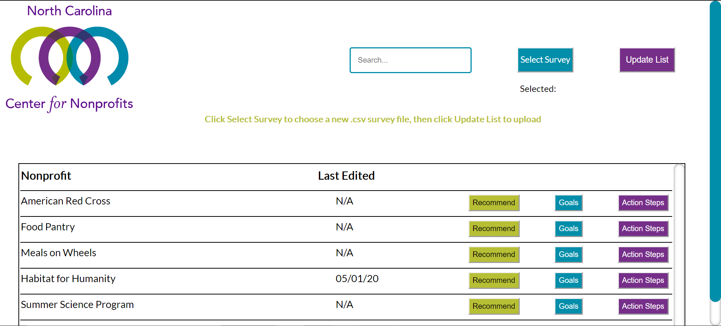
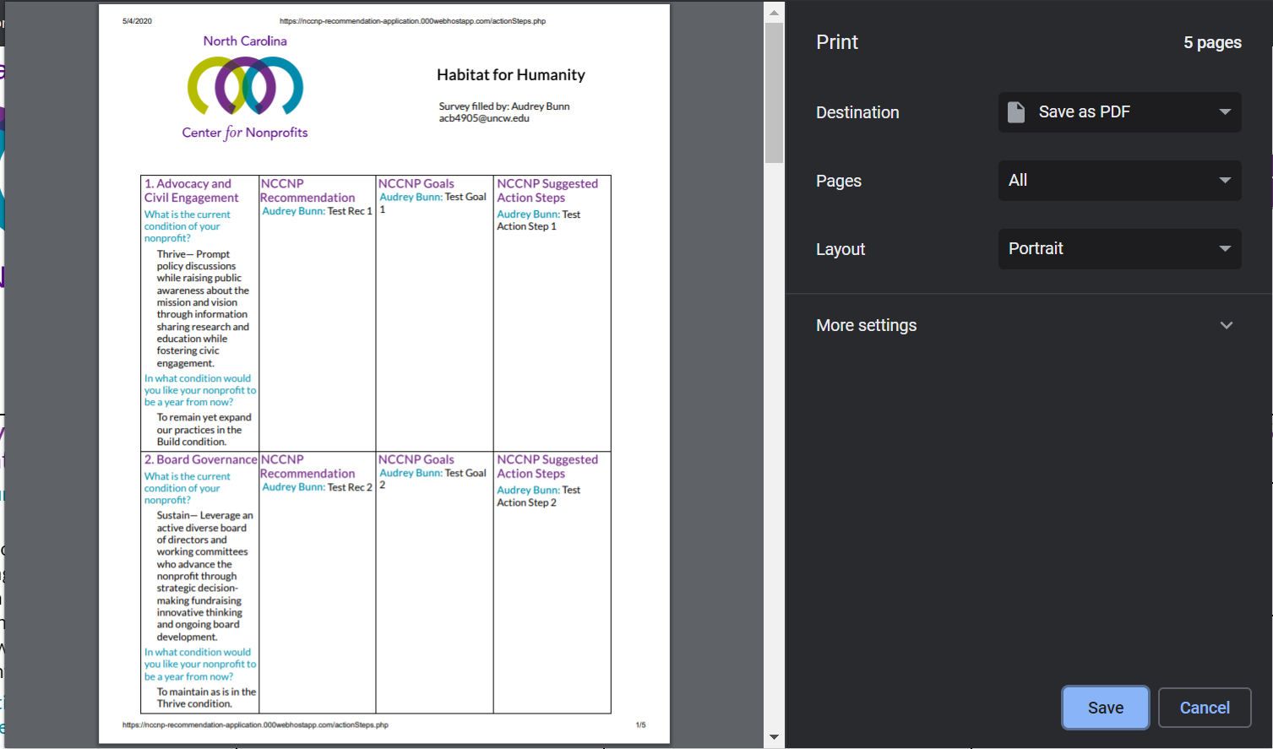
System Analysis
PHP application hosted on 000Webhost server
Concurrent Saving:
Survey .csv files are saved in a survey folder
User inputs are stored in .txt files in their respective folders
recommendationSaveData, goalsSaveData, actionStepsSaveData
Exporting is handled with JavaScript window.print() and CSS

Slide 8
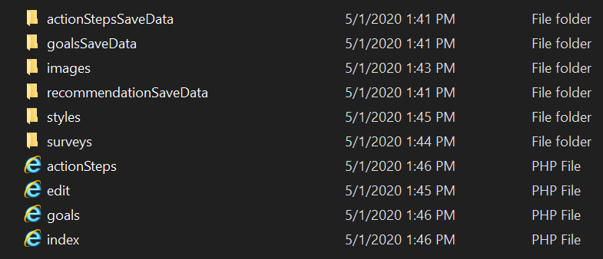
Module Structure
SaveData files - store user inputs
Images and styles - resources folders for images and .css
Surveys - Survey Monkey .csv files, one for each nonprofit
Page 1 - index.php, Page 2 - edit.php, Page 3 - goals.php, Page 4 - actionSteps.php

Slide 9
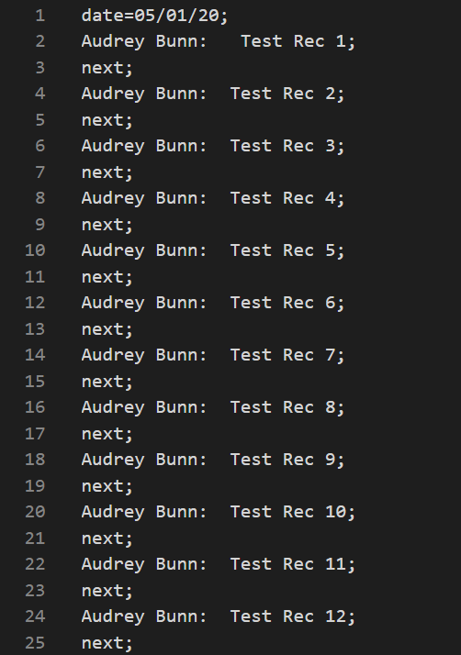
Save File Structure
Line 1 - Last modified date to display on page 1
Index.php code parses through all save data files for a nonprofit to get the most recent date.
Saved text entries go between next; lines
Each user entry gets its own line
Next; comes after all of the entries for a survey response
ex.) Line 2 = question 1 response, Line 4 = question 2 response...

Slide 10
Testing
Testing efforts:
Thoroughly tested use cases from process start to finish
NCCNP employees’ trial run
Desired outcomes:
Find bugs and styling issues
Identify new desired features
Improve undesirable or imperfect features
Receive feedback from NCCNP and nonprofits about the new capacity building process
Notes:
So our testing included our own use cases we thought the system would go through on an average sitting or usage and ensuring that the system can handle multiple inputs from different machines. From there, we did a trial run with NCCNP and hopefully we will find some features that would be desirable in the final program and any other bugs and changes that stem from that. Hopefully, more feedback from NCCNP and the nonprofits will help us improve the system and make this program last.

Slide 11
Demo

Slide 12
Future Goals
Transfer files to NCCNP’s server for hosting
Improve the application with desired new features like:
Deleting erroneous user entries
Deleting old surveys
Improve user experience if needed
Remain available to fix issues
Prepare the code to be shared with the next UNCW group if needed

